Slide 1
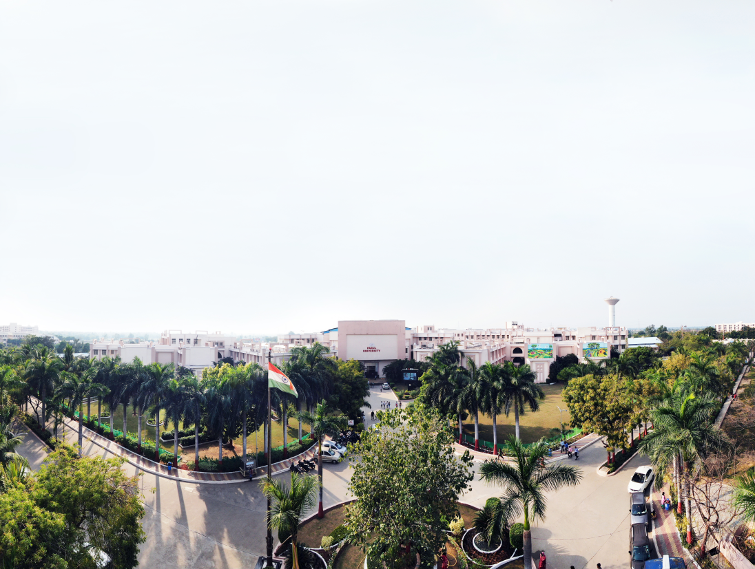


Object Oriented Concepts with UML
203105207
Prof. Tejal Patel, Assistant Professor
Information Technology Department

Slide 2
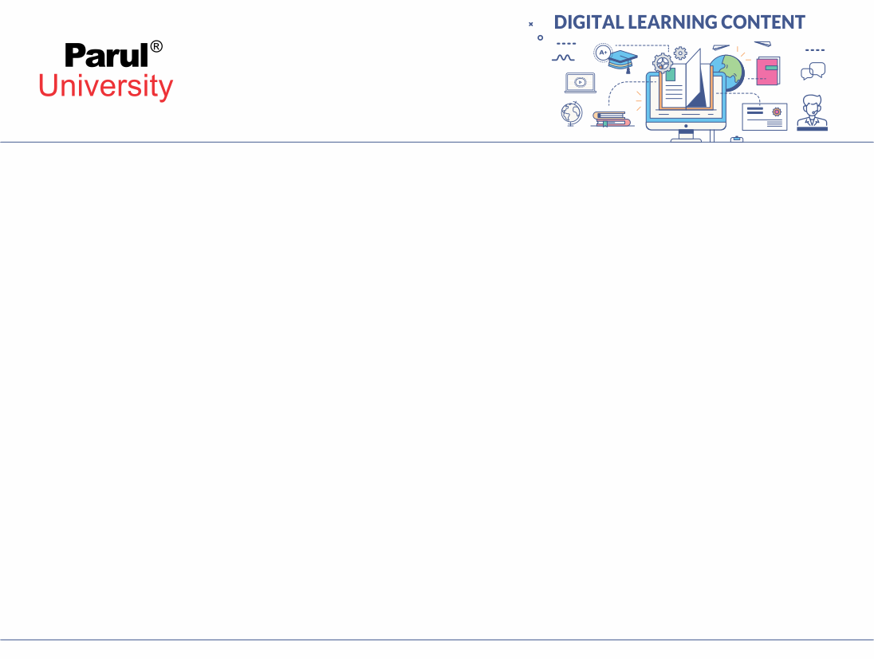

Interaction Models
The class model describes the class & objects in a system and their relationship.
The state model describes the life cycles of the objects.
The interaction model describes how the objects interact.
The interaction model starts with use cases that are then elaborated with sequence and activity diagrams

Slide 3
Interaction Models
Use case: focuses on functionality of a system- i.e, what a system does for users
Sequence diagrams: shows the object that interact and the time sequence of their interactions
Activity diagrams: elaborates important processing steps

Slide 4
CHAPTER-3
Use Case Models

Slide 5
Introduction
Use cases are description of the functionality of a system from user perspective.
It shows the relationships between the actors(Users) that use the system, the use cases(functionalities) they use and the relationships between different use cases.

Slide 6
Use Case Diagrams
Use Case diagrams show the various activities the users can perform on the system.
  System is something that performs a function.
They model the dynamic aspects of the system.
Provides a user’s perspective of the system

Slide 7
Use-Case Diagrams
A use case is a model of the interaction between External users of a software product (actors) and The software product itself
More precisely, an actor is a user playing a specific role describing a set of user scenarios capturing user requirements contract between end user and software developers

Slide 8
Using Use Case Diagrams
Use case diagrams are used to visualize, specify, construct, and document the (intended) behavior of the system, during requirements capture and analysis.
Provide a way for developers, domain experts and end-users to Communicate.
Serve as basis for testing.
Use case diagrams contain use cases, actors, and their relationships.

Slide 9
Use-Case Diagrams
Actor: A role that a user plays with respect to the system, including human users and other systems. e.g., inanimate physical objects (e.g. robot); an external system that needs some information from the current system.
Use case: A set of scenarios that describing an interaction between a user and a system, including alternatives.
System boundary: rectangle diagram representing the boundary between the actors and the system.
Association: Communication between an actor and a use case; Represented by a solid line.

Slide 10
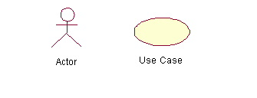
Use-Case Diagrams

Slide 11
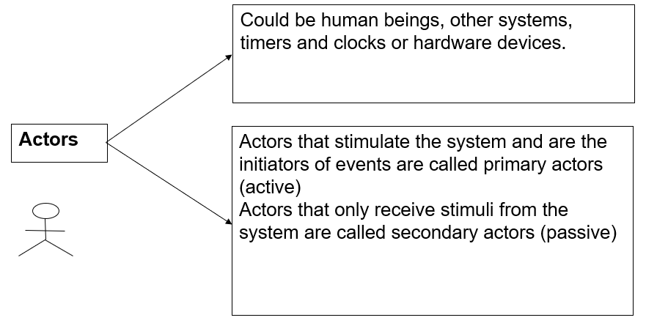
Actors

Slide 12
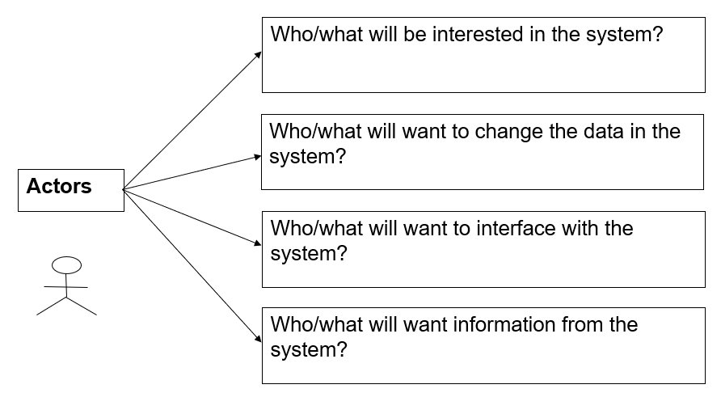
Actors

Slide 13
Use Case Diagram– Guidelines & Caution
Avoid showing communication between actors.
Actors should be named as singular. i.e student and NOT students. NO names should be used – i.e John, Sam, etc.

Slide 14
Use-Case Diagrams: Actors and Goals
Start by identifying the actors of the system
Define the goals of the system and how they can be achieved using the systems’ actors
Illustrate these goals and actors actions using use-case diagram(s)

Slide 15
Use-case Diagram: Use-case
A use case describes a sequence of actions a system performs to yield an observable result or value to a particular actor
Naming convention = verb + noun (or) verb + noun-phrase,
  e.g. withdraw cash
A good use case should:
  Describe a sequence of transactions performed by a system that produces a measurable result (goal) for a particular actor
  Describe the behavior expected of a system from a user's perspective
  Enable the system analyst to understand and model a system from a high-level business viewpoint
  Represent the interfaces that a system makes visible to the external entities and the interrelationships between the actors and the system

Slide 16
Use Case Diagrams – Use Cases
Use case is a particular activity a user can do on the system.
Is represented by an ellipse.
Following are two use cases for a library system.
Borrow
Reserve

Slide 17
Identifying use cases for a system
What are the tasks of each actor?
Will any actor create, store, change, remove, or read the information?
Will any actor need to inform the system about the sudden, external changes?
Does any actor need to informed about certain occurrences in the system?
What use cases will support and maintain the system?
Can all functional requirements be performed by the use cases?

Slide 18
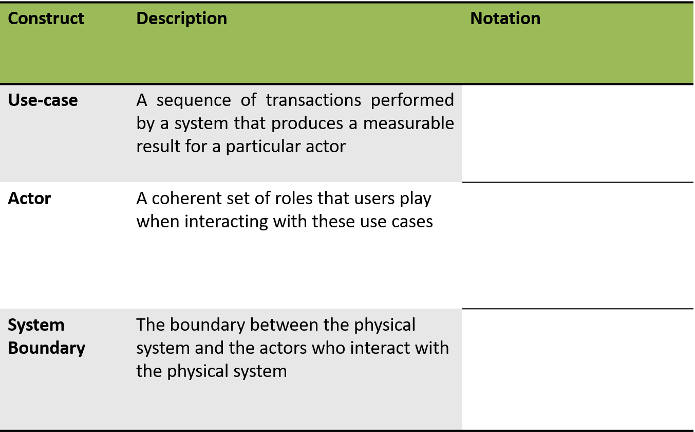
Summary of Notations

Slide 19
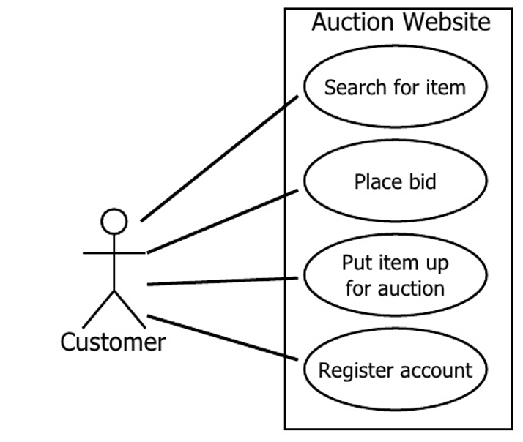
Auction Website Use Cases

Slide 20
Use cases
Functionality provided by the system
Consist of a series of steps which collectively add value to the user of the system
Examples
  Issue a book to a member
  Receive a book back from a member
  Query the current location of a book
  Maintain member’s information
  Maintain book’s information

Slide 21
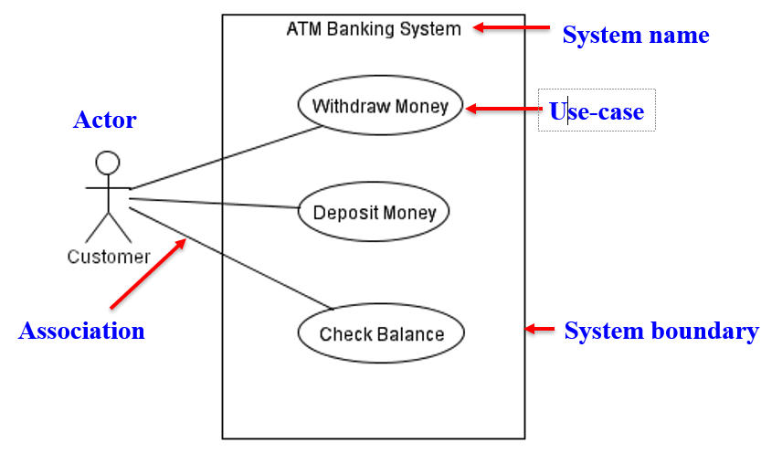
Use-Case Diagram: Example

Slide 22
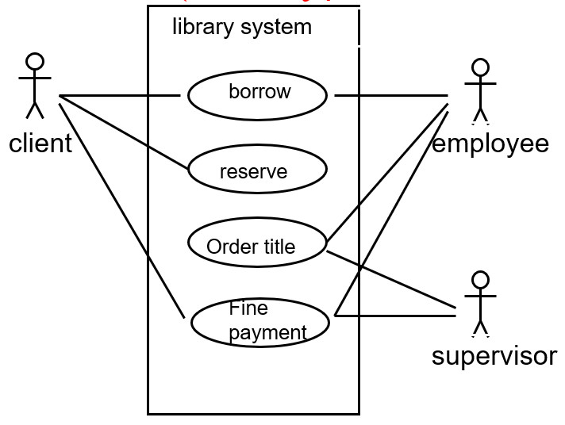
Use Case Diagram – Example1 (Library)

Slide 23
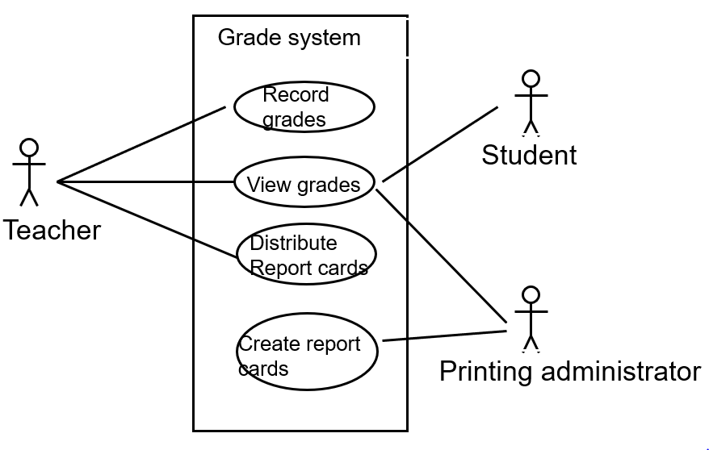
Use Case Diagram for Student Assessment Management System

Slide 24
Use-Case Diagrams
Include: a dotted line labeled <<include>> beginning at base use case and ending with an arrows pointing to the include use case. The include relationship occurs when a chunk of behavior is similar across more than one use case. Use “include” in stead of copying the description of that behavior.
Extend: a dotted line labeled <<extend>> with an arrow toward the base case. The extending use case may add behavior to the base use case. The base class declares “extension points”.

Slide 25
Include
base
<<include>>
included
The base use case explicitly incorporates the behavior of another use case at a location specified in the base.
The included use case never stands alone. It only occurs as a part of some larger base that includes it.

Slide 26
More about Include
Enables to avoid describing the same flow of events several times by putting the common behavior in a use case of its own.
updating
grades
<<include>>
verifying
student id
output
generating
<<include>>

Slide 27
The <<include>> Relationship
Include relationships are used when two or more use cases share some common portion in a flow of events
This common portion is then grouped and extracted to form an inclusion use case for sharing among two or more use cases
Most use cases in the ATM system example, such as Withdraw Money, Deposit Money or Check Balance, share the inclusion use-case Login Account

Slide 28
Extend
The base use case implicitly incorporates the behavior of another use case at certain points called extension points.
The base use case may stand alone, but under certain conditions its behavior may be extended by the behavior of another use case.
base
<<extend>>
extending

Slide 29
The <<extend>> Relationship
In UML modeling, you can use an extend relationship to specify that one use case (extension) extends the behavior of another use case (base)
This type of relationship reveals details about a system or application that are typically hidden in a use case

Slide 30
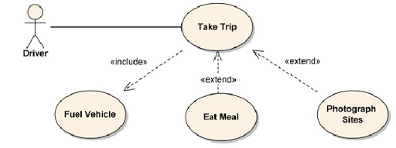
The <<extend>> Relationship

Slide 31
Sequence Models

Slide 32
Sequence Diagrams
Sequence diagrams, also known as event diagrams or event scenarios, illustrate how processes interact with each other by showing calls between different objects in a sequence.
These diagrams have two dimensions:
The vertical lines show the sequence of messages and calls in chronological order
Horizontal elements show object instances where the messages are relayed.

Slide 33
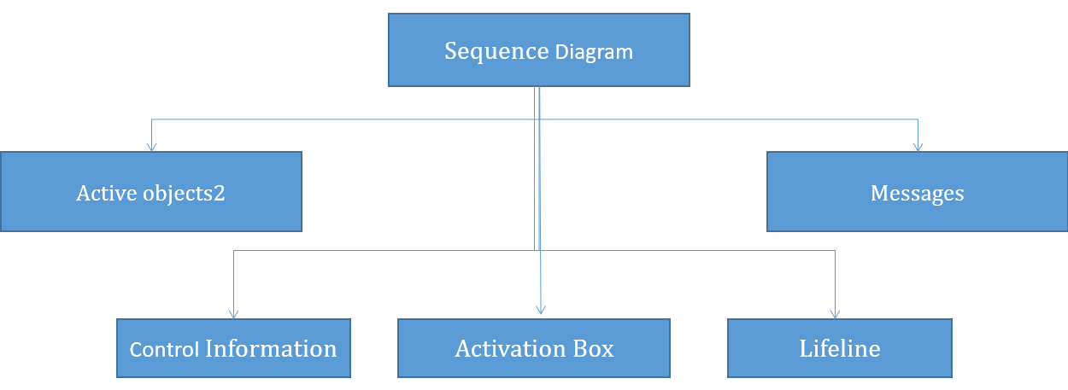
Sequence Diagram

Slide 34
SEQUENCE DIAGRAM (Important Components)
Active Objects:
  Any objects that play a role in the system
  Can be any object or class that is valid within the system
  Can be an Actor that is external to the system and derives benefits from the system
Messages:
  Used to illustrate communication between different active objects.
  Used when an object needs
    To activate a process of a different object
    To give information to another object

Slide 35
SEQUENCE DIAGRAM (other Components)
Lifeline
  Denotes the life of actors/objects over time during a sequence
Focus of control (activation box)
  Means the object is active and using resources during that time period
Control information
  Shows the control flow in the system
  Creation and destruction of an object through <<create>> and <<destroy>>

Slide 36
Representing Objects
Squares with object type, optionally preceded by object name and colon
Write object's name if it clarifies the diagram
Object's "life line" represented by dashed vertical line

Slide 37
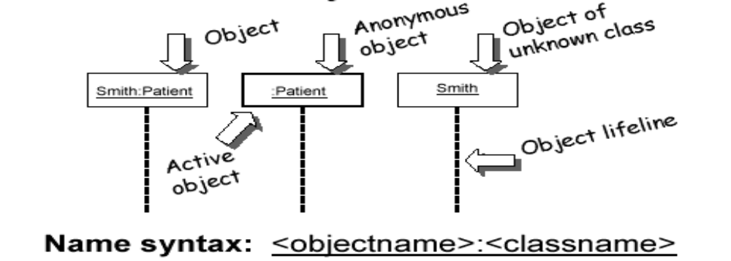
Representing Objects

Slide 38
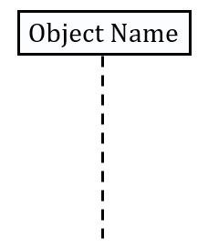
Lifeline
Objects are displayed at the top of the diagram
The vertical dimension represents time
Each object has a dashed line – lifeline – extending below it – to indicate the period of time during which objects playing that role actually exist

Slide 39
Lifetime of objects
Creation: An arrow with 'new' written above it
Deletion: An X at bottom of object's lifeline

Slide 40
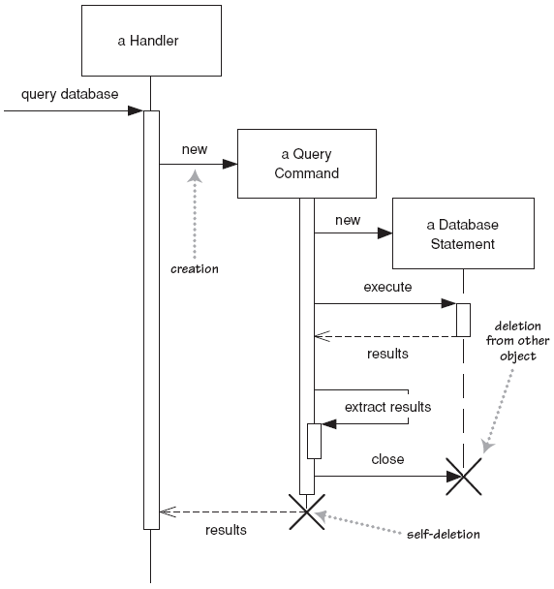
Lifetime of objects

Slide 41
Message
The messages in an interaction are drawn from top to bottom, in the order that they are sent.
Messages are shown as arrows pointing from the lifeline of the role sending the message to the lifeline of the receiver.
When a message is sent, control passes from the sender of the message to the receiver.

Slide 42
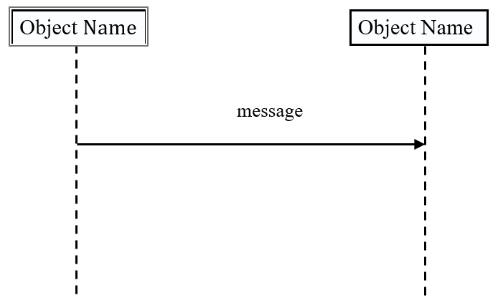
Message

Slide 43
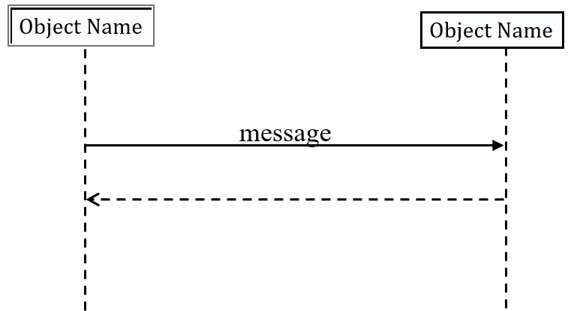
Return
Return of control is shown using dashed arrow returning to the calling object.

Slide 44
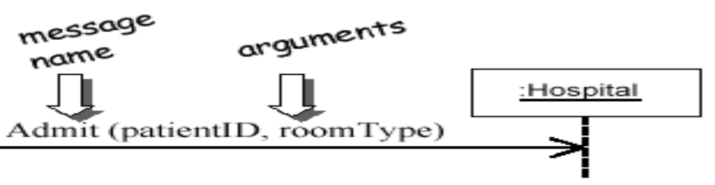
Messages between Objects
Message (method call) indicated by horizontal arrow to other object
Write message name and arguments above arrow

Slide 45
Indicating method calls
Activations - show when a method is active – either executing or waiting for a subroutine to return
Either that object is running its code, or it is on the stack waiting for another object's method to finish

Slide 46
Activation
Period of time during which an object is processing a message, Shown on a lifeline as a narrow rectangle whose top is connected to a message.
When an object finishes processing a message, control returns to the sender of the message

Slide 47
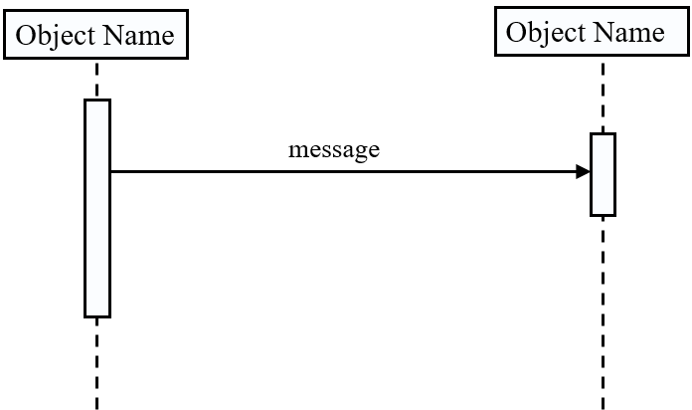
Activation

Slide 48
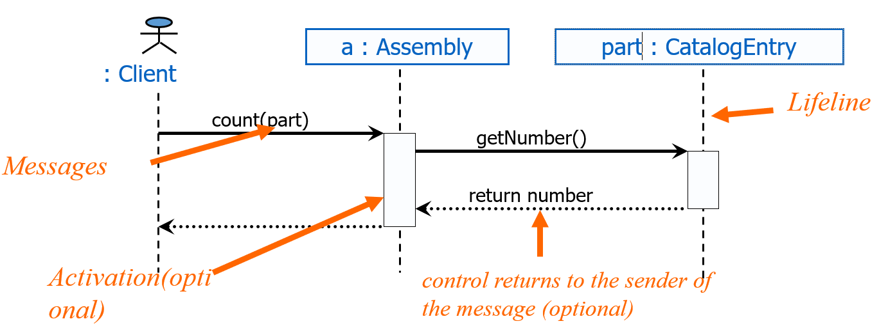
Sequence Diagram

Slide 49
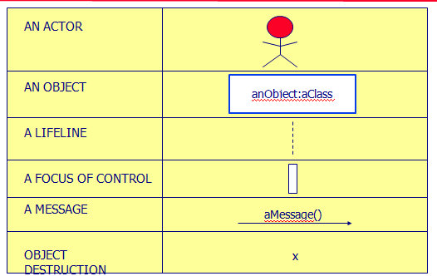
Sequence Diagram Syntax

Slide 50
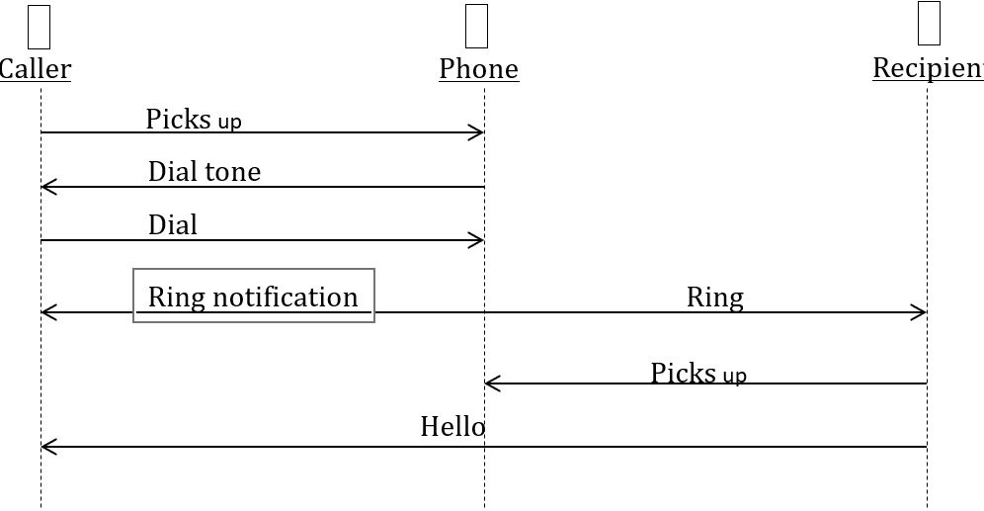
Sequence Diagram(make a phone call)

Slide 51
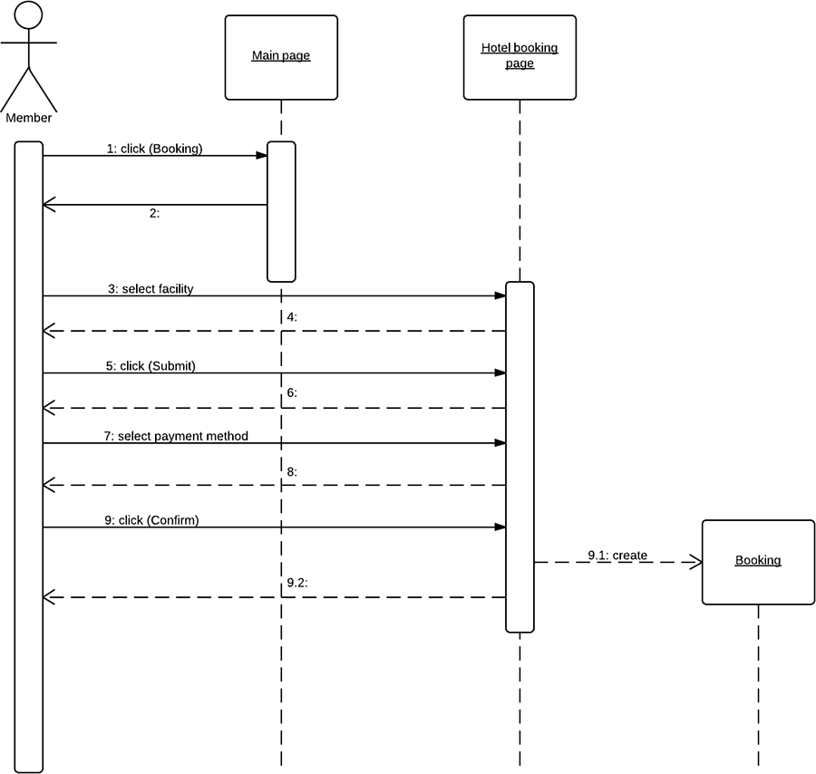
Activation
Period of time during which an object is processing a message, Shown on a lifeline as a narrow rectangle whose top is connected to a message.
When an object finishes processing a message, control returns to the sender of the message

Slide 52


www.paruluniversity.ac.in

